Slide 1
Short News Portal
Supervised By :
Dr. K. M. Azharul Hasan
Professor,
Department of Computer Science & Engineering
Khulna University of Engineering & Tecnology (KUET)
Submitted By :
Abdullah Al Shafi
Roll: 1807004
Ankan Saha
Roll: 1807060
3rd Year 2nd semister

Slide 2
Contents of Presentation
Introduction
Objectives
Methodology
Features
Implementation
Future scope for improvement
Conclusion
References

Slide 3
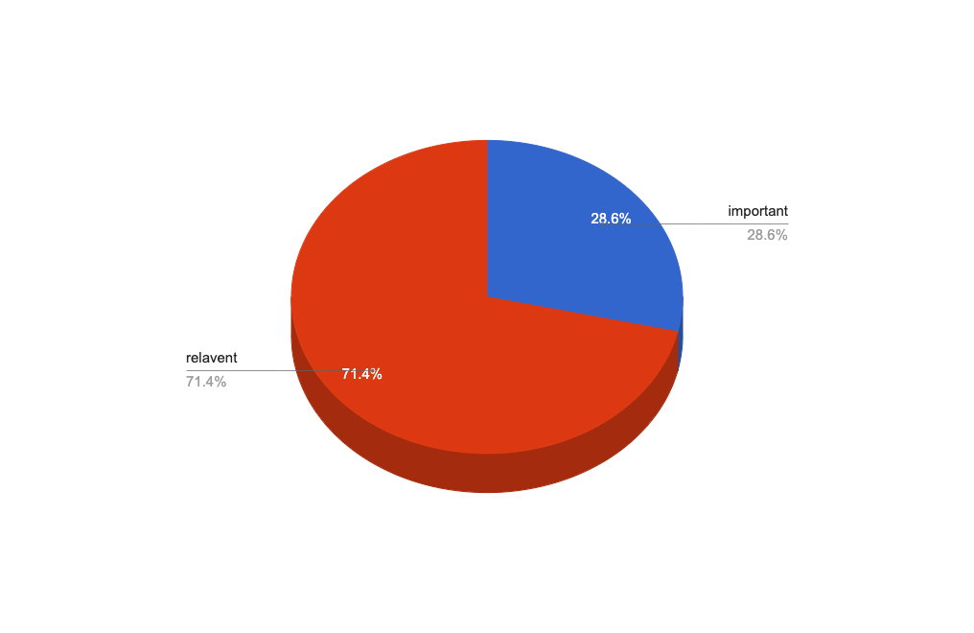
Introduction
Today, the tremendous information is available on the internet; it is difficult to get the information fast and most efficiently.
There are so many text materials available on the internet, in order to extract the most relevant information from it, we need a good mechanism.
Text summarization technique deals with the compression of large document into shorter version of text.

Slide 4
Objectives
To build a web application with the following goals:
To identify the most important information from the given text and present it to the end users.
To show various categories of news in summarized form.
To compare different types of summarization algorithm.

Slide 5
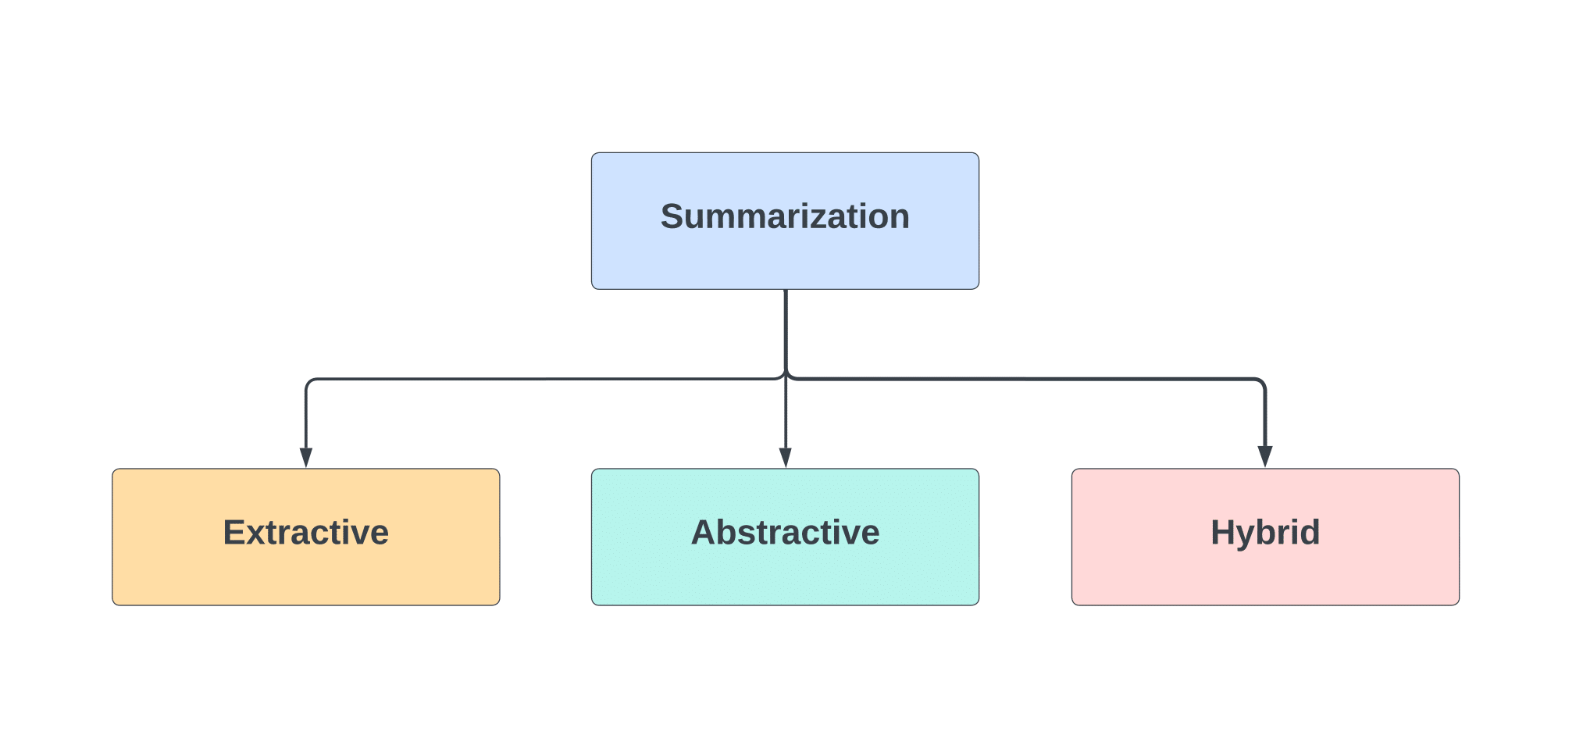
Methodology
Figure : Types of Text Summarization[1]

Slide 6
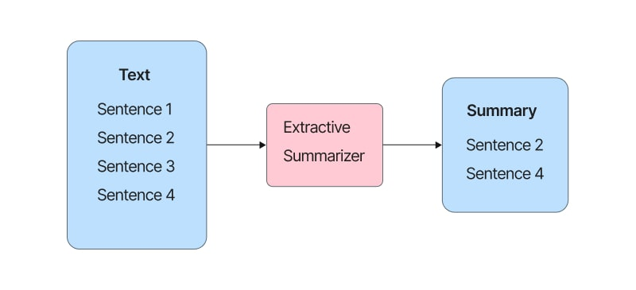
Methodology(Cont’d)
Figure : Extractive Text Summarization [2]

Slide 7
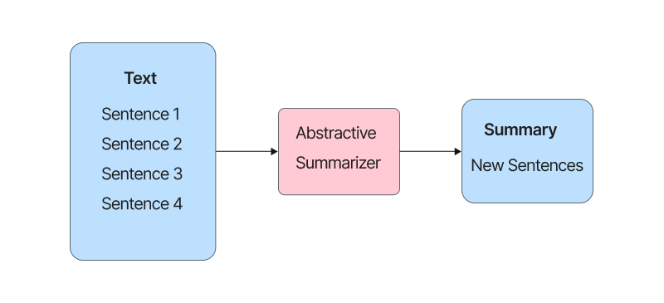
Methodology(Cont’d)
Figure : Abstractive Text Summarization[3]

Slide 8
Methodology(Cont’d)
Extractive Summarization:
Term Frequency(TF) Algorithm
Text Rank Algorithm
Abstractive Summarization:
Using T5 Transformers model

Slide 9
Methodology(Cont’d)
Term Frequency Algorithm

Slide 10
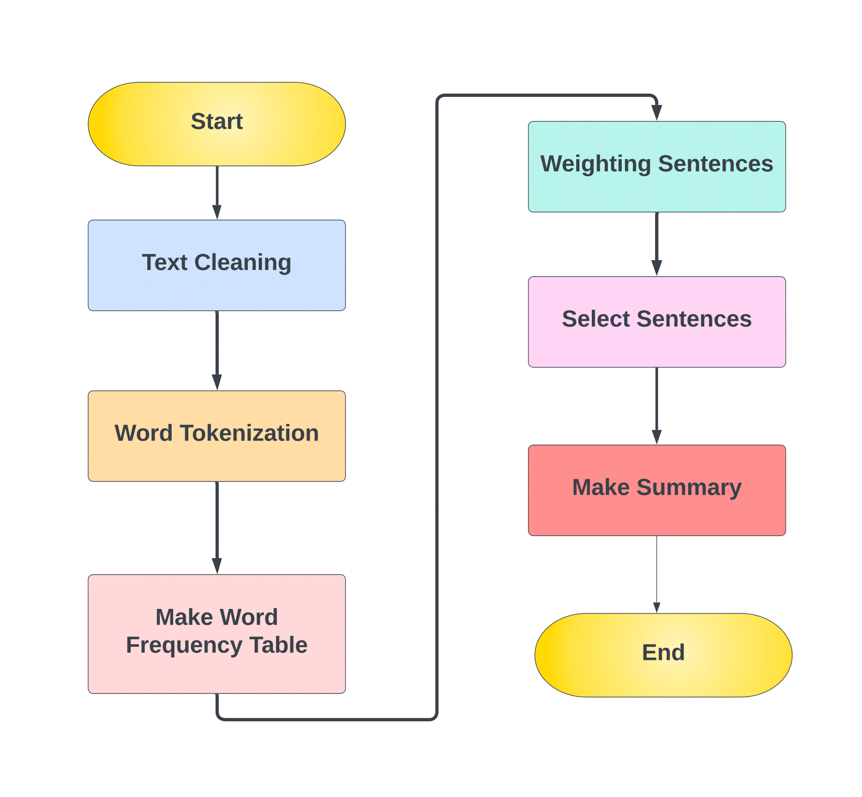
Methodology(Cont’d)
Figure : Flowchart of Term Frequency(TF) Algorithm

Slide 11
Methodology(Cont’d)
text = “Machine learning is a field of inquiry . Machine learning is a part artificial intelligence . Machine learning algorithm build model.”
word frequencies
normalized frequencies
sentence score
machine | 3
learning | 3
inquiry | 1
artificial | 1
intelligence | 1
algorithms | 1
build | 1
model | 1
machine | 1
learning | 1
inquiry | 0.33
artificial | 0.33
intelligence | 0.33
algorithms | 0.33
build | 0.33
model | 0.33
s1 | 1.33
s2 | 1.0
s3 | 1.66
summary = {s3} = “Machine learning algorithm build model.”

Slide 12
Methodology(Cont’d)
Text Rank Algorithm

Slide 13
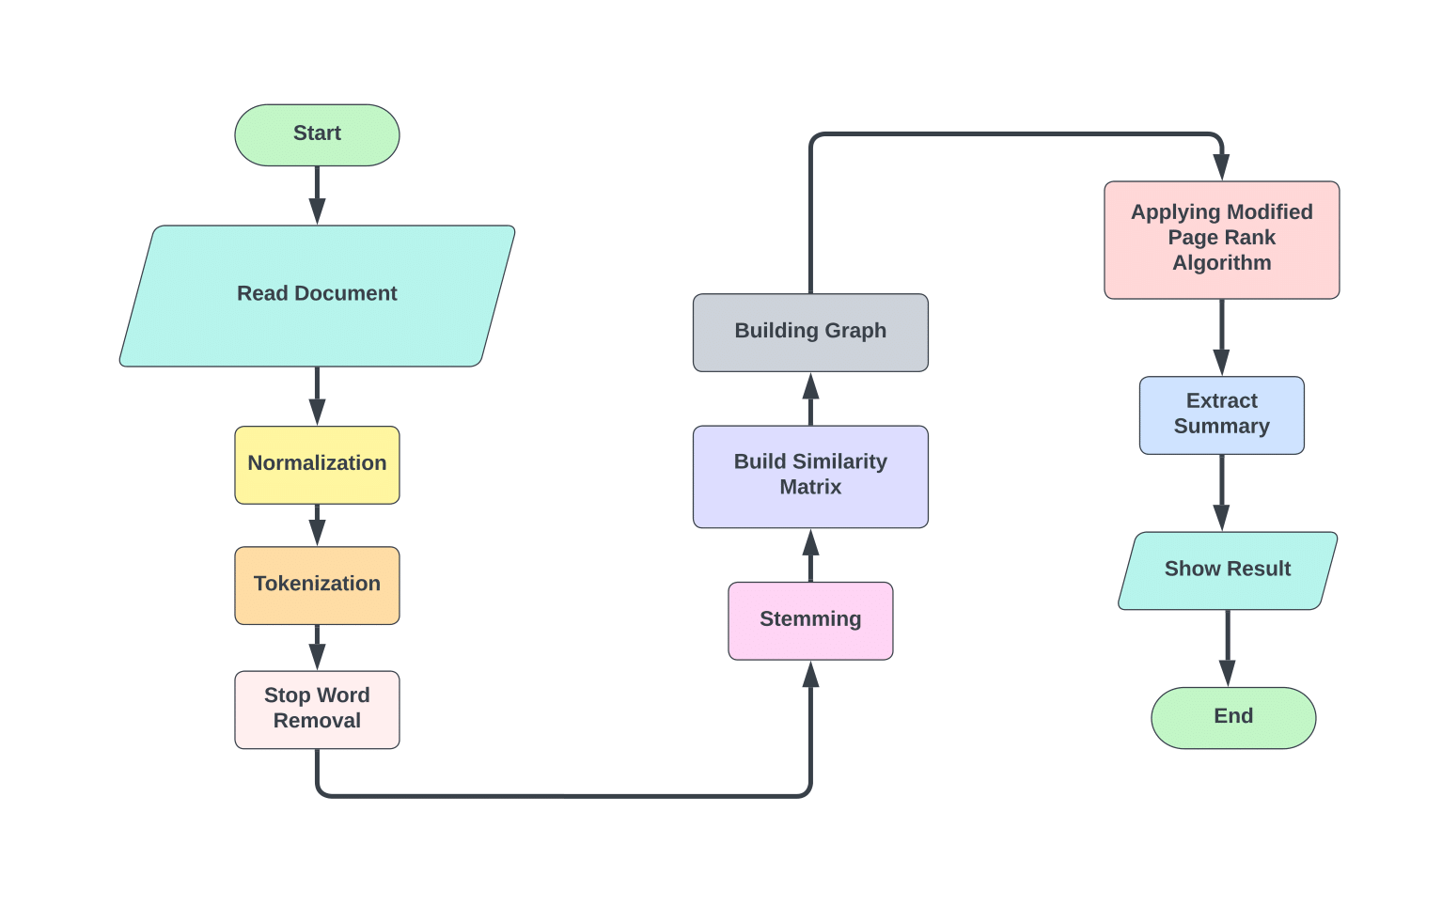
Methodology(Cont’d)
Figure : Flowchart of Text Rank Algorithm

Slide 14
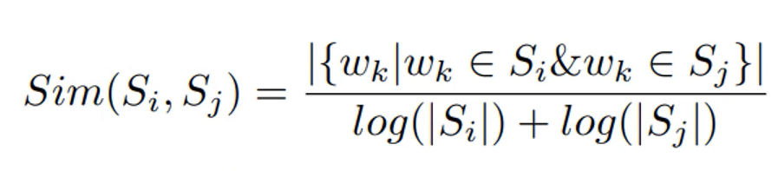
Methodology(Cont’d)
Given S_{i} , S_{j} two sentences represented by a set of n words that in S_{i} are represented as S_{i} = w₁^{i} w₂^{i} … w_{n}i. The similarity function for S_{i},S_{j} can be defined as:
The result is a dense graph representing the document.From this graph , PageRank is used to compute the importance of each vertex.The most significant sentences are selected and presented in the same order as they appear in the document as the summary.

Slide 15
Methodology(Cont’d)
 | s1 | s2 | s3 | s4
s1 | 0 | 0.2 | 0.1 | 0.4
s2 | 0.2 | 0 | 0.1 | 0.2
s3 | 0.1 | 0.1 | 0 | 0.4
s4 | 0.4 | 0.2 | 0.4 | 0
 | Init prob
s1 | 0.25
s2 | 0.25
s3 | 0.25
s4 | 0.25
 | New prob
s1 | 0.098
s2 | 0.08
s3 | 0.092
s4 | 0.11
 | New prob
s4 | 0.11
s1 | 0.098
s3 | 0.092
s2 | 0.08

Slide 16
Methodology(Cont’d)
Abstractive Summarization

Slide 17
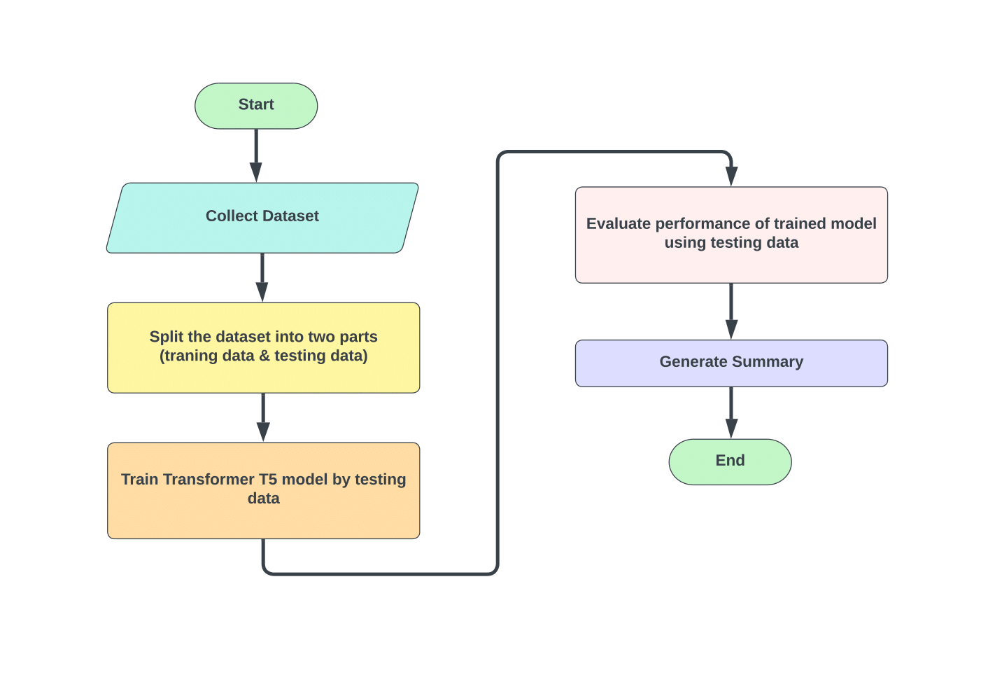
Methodology(Cont’d)
Figure : Flow chart of Abstractive Text Summarization

Slide 18
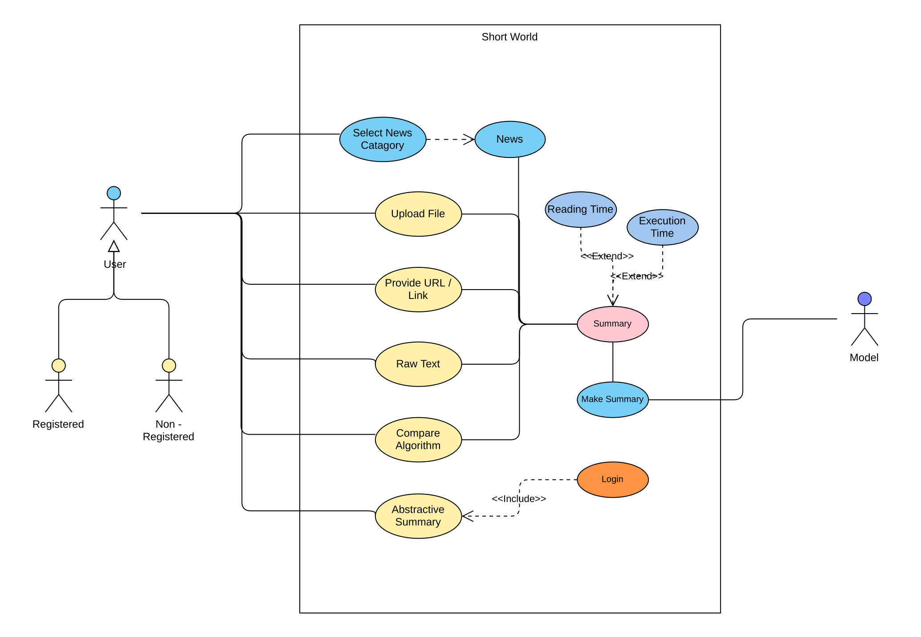
Methodology(Cont’d)
Figure : Use case Diagram of the System

Slide 19
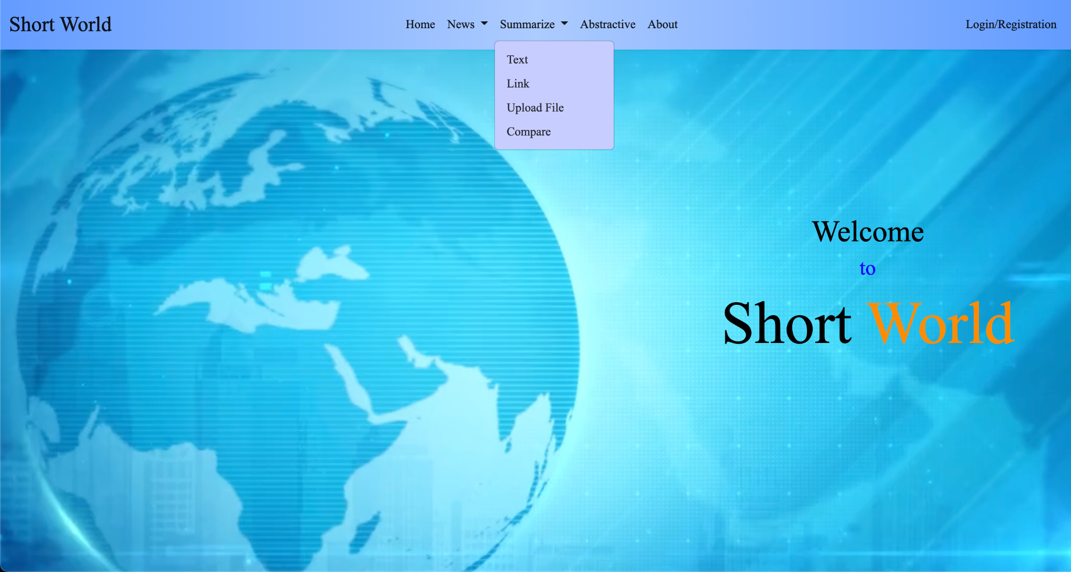
Features:
Three different options to provide text data.

Slide 20
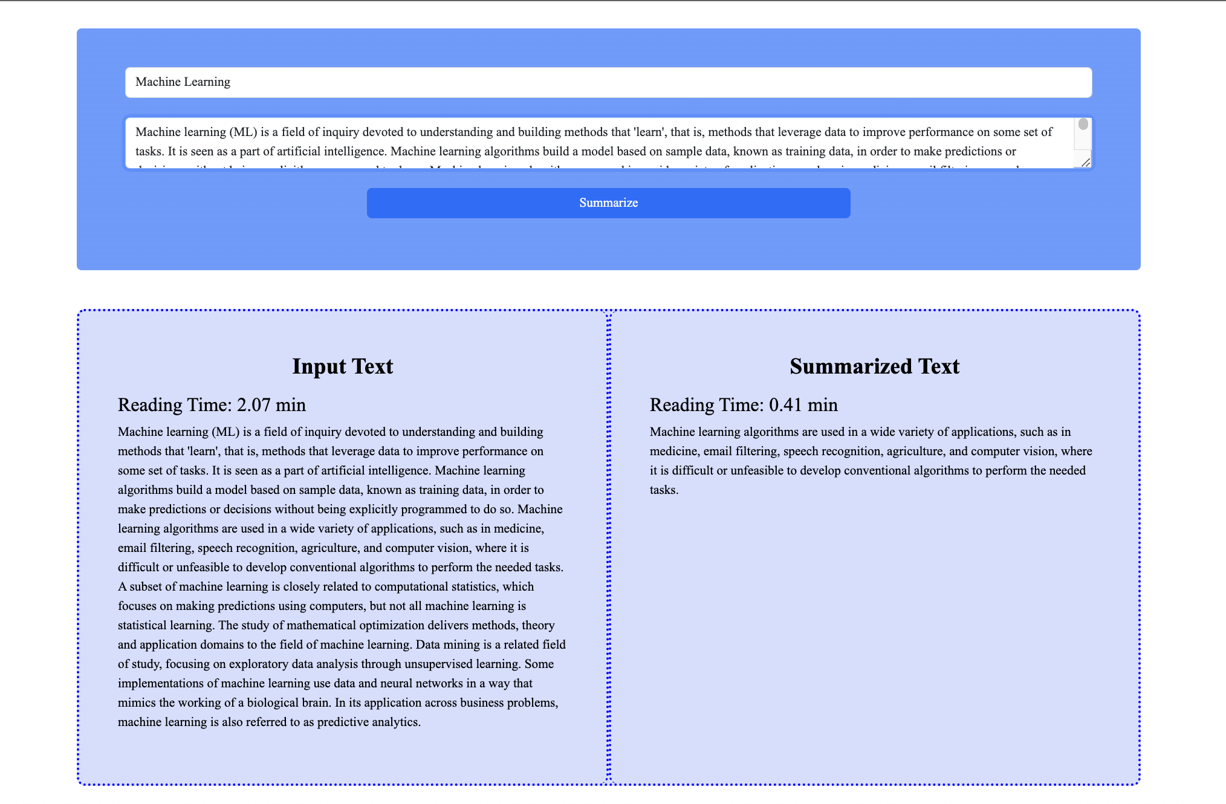
Features:
Summarize using Raw Text

Slide 21
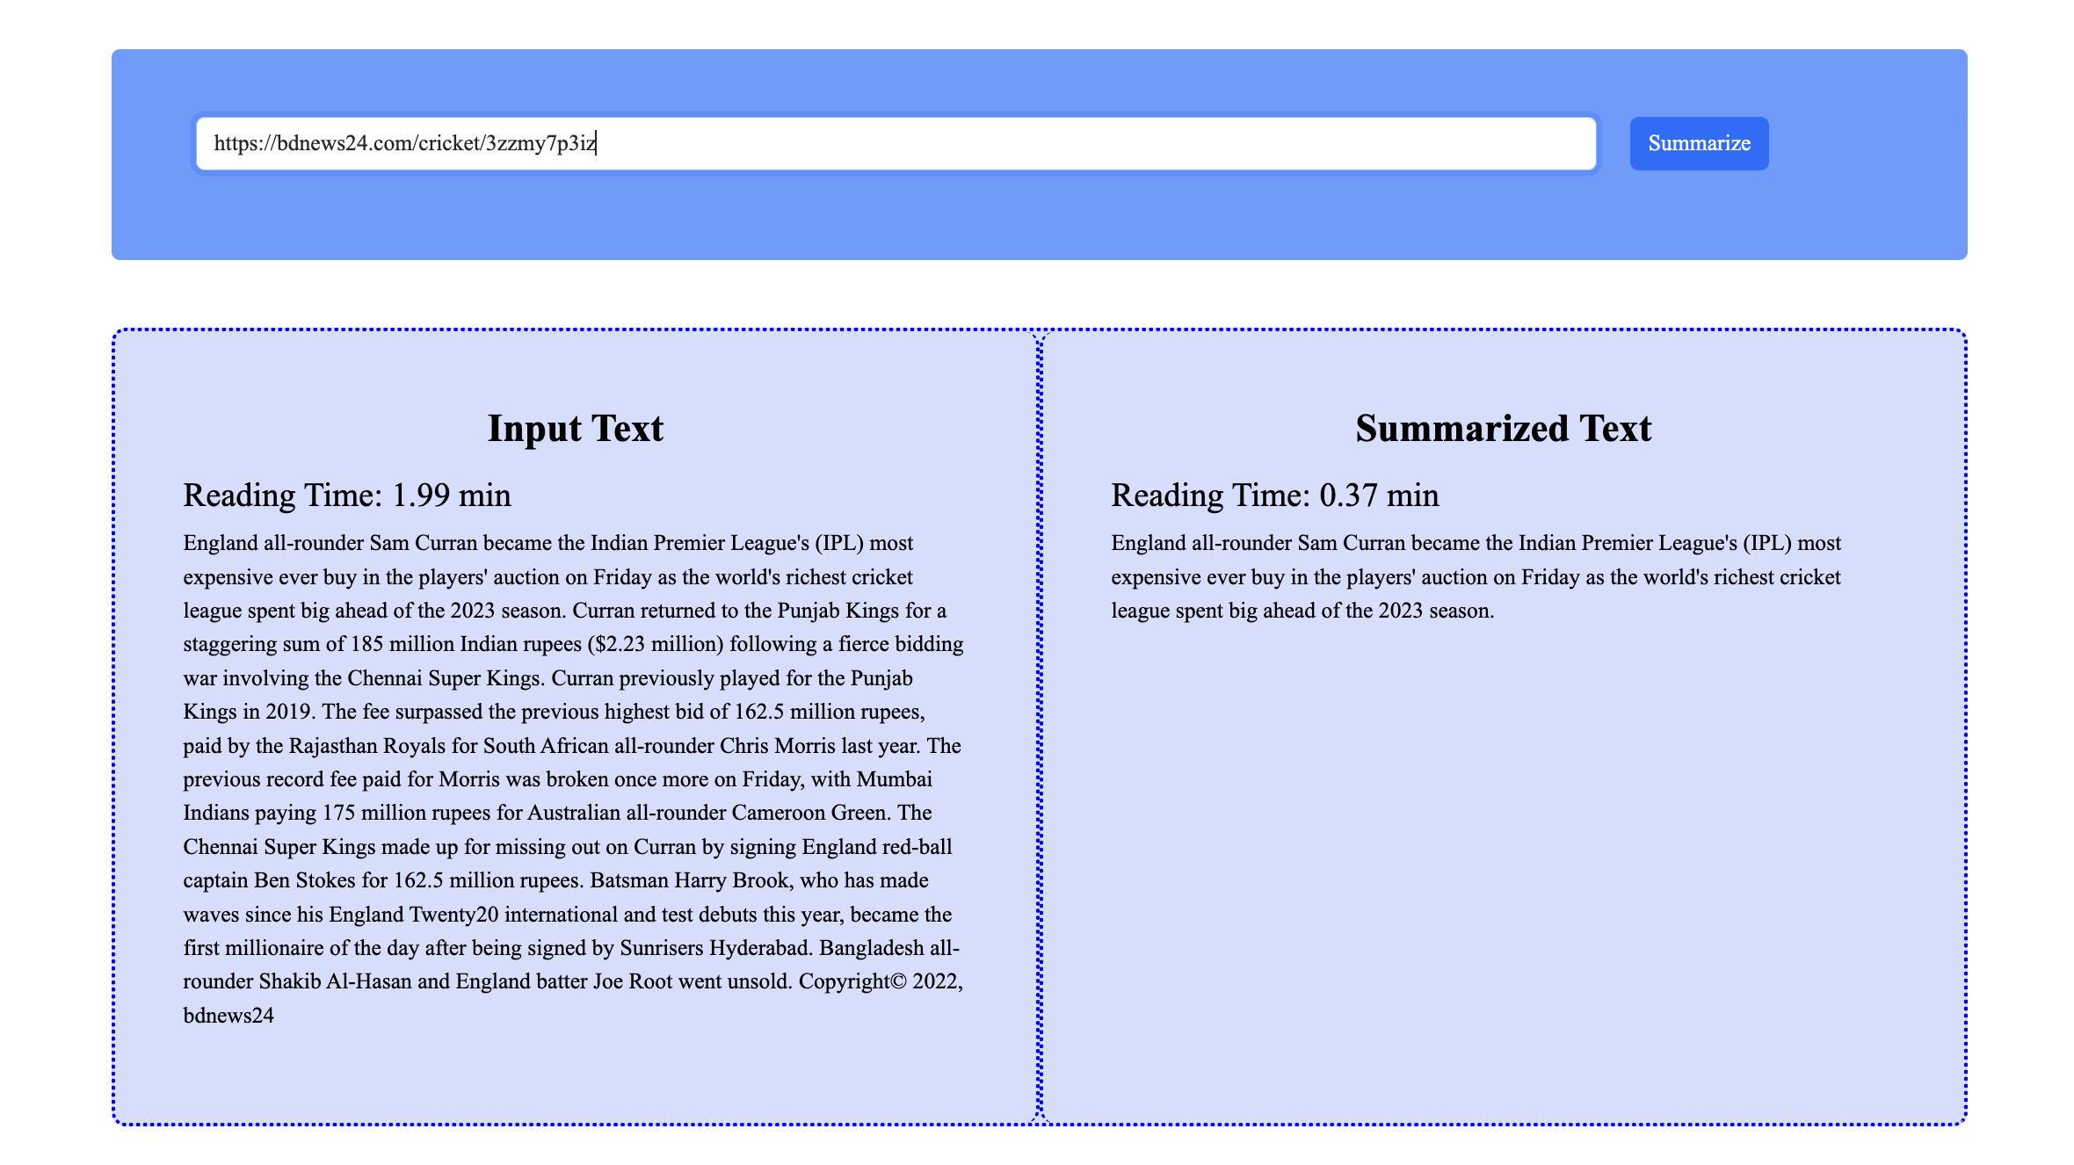
Features:
Summarize using Provided Link

Slide 22
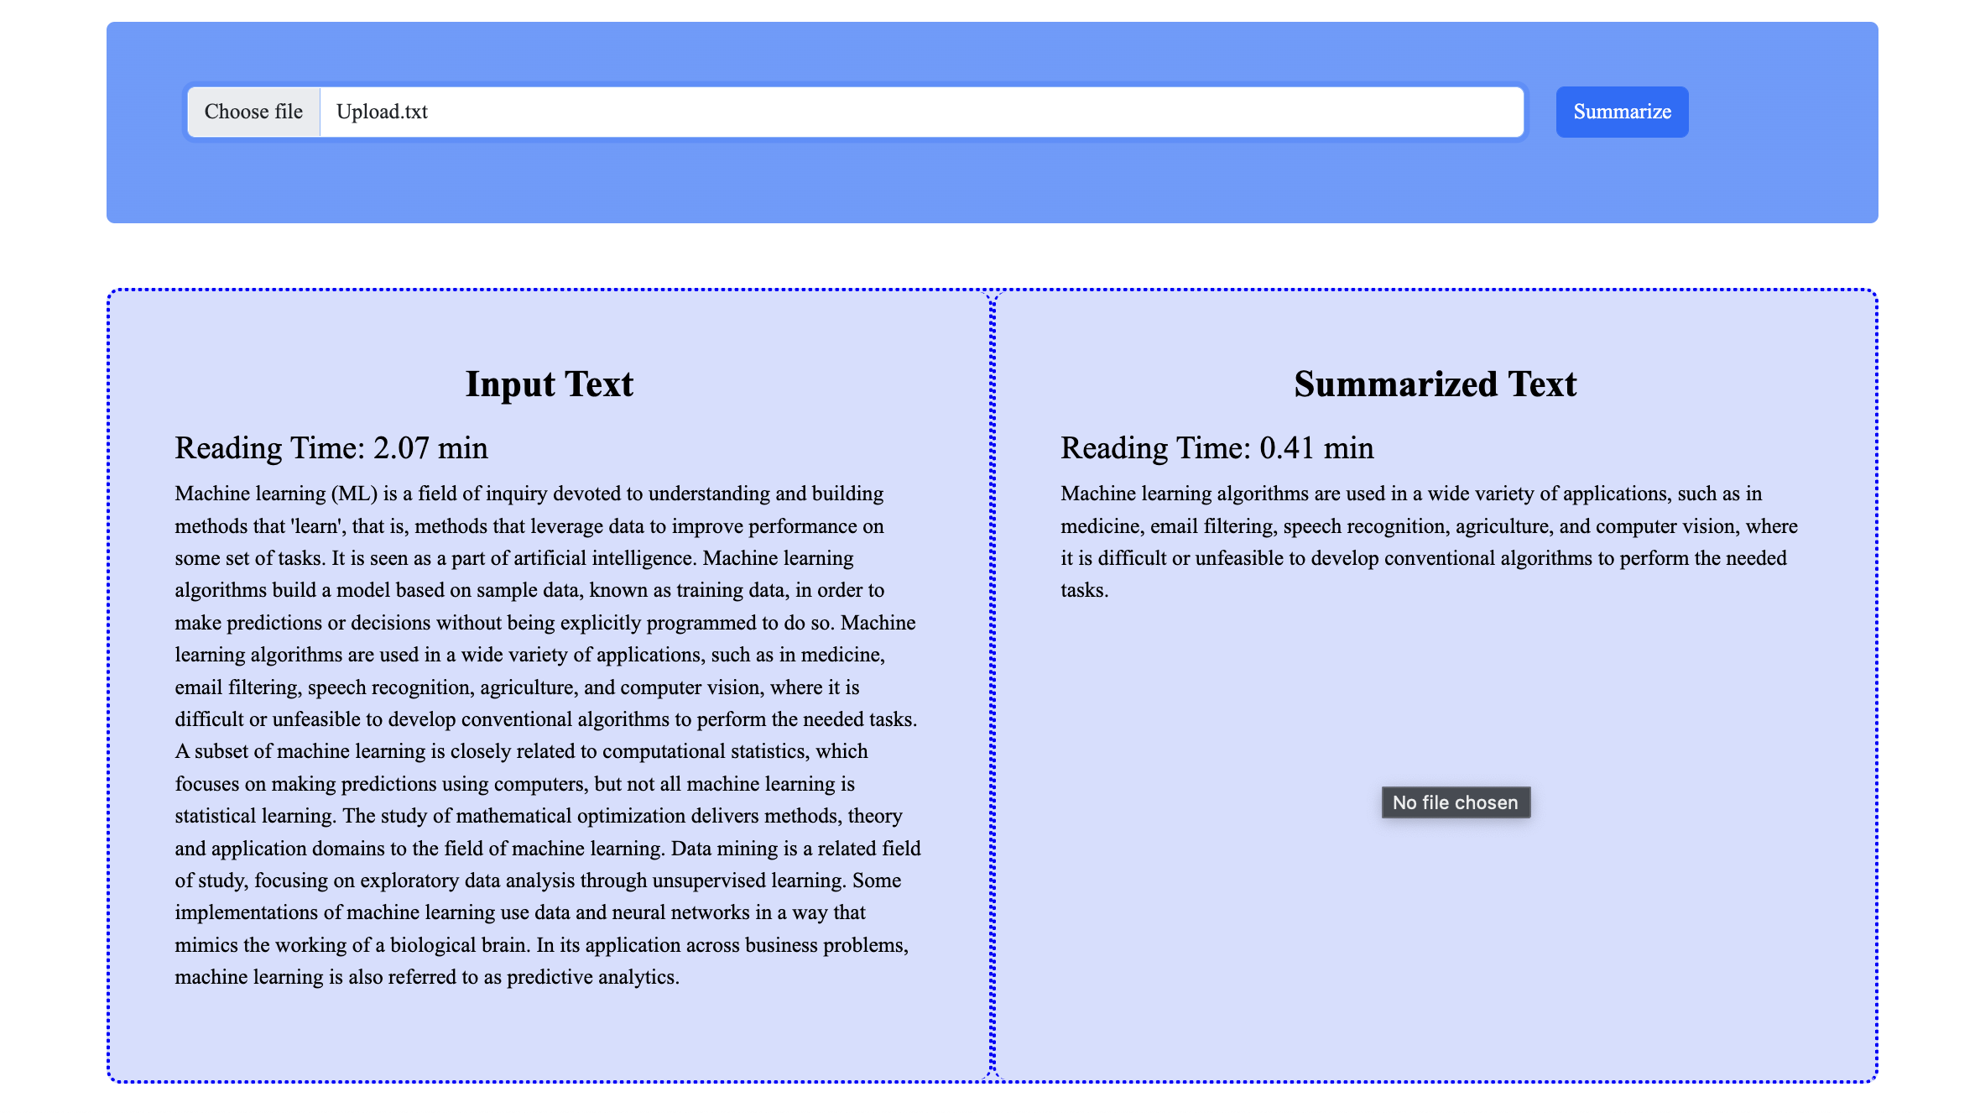
Features:
Summarize using Uploaded File.

Slide 23
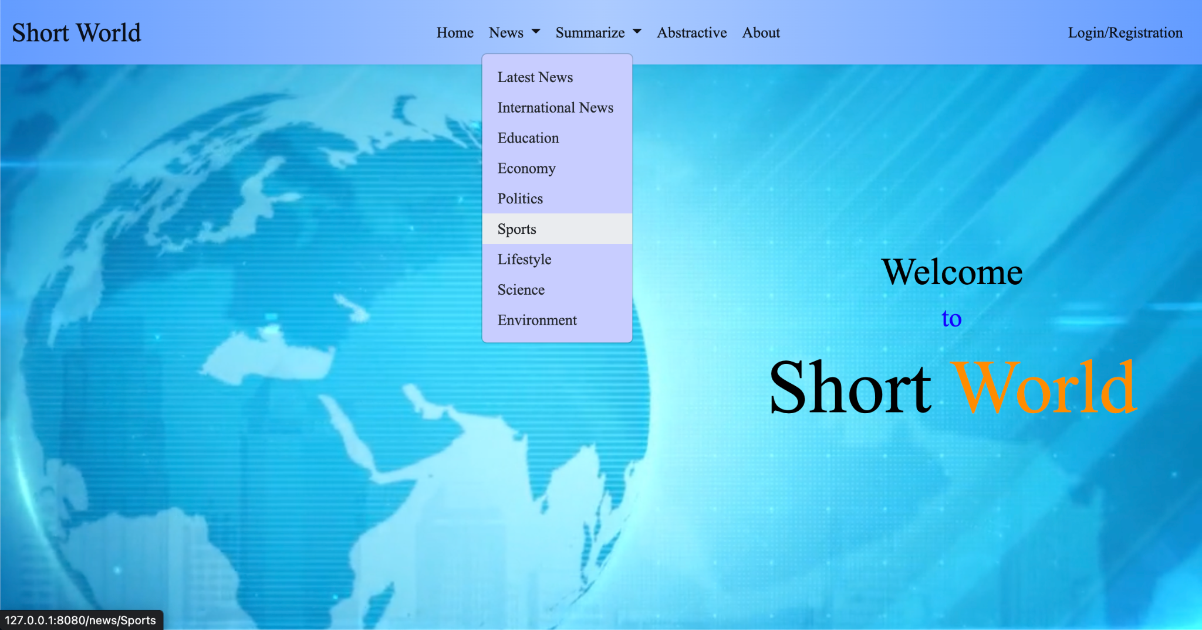
Features:
Selection of news category from different categories.

Slide 24
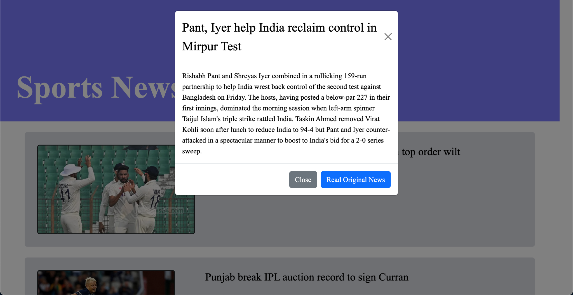
Features:
Showing summarized news

Slide 25
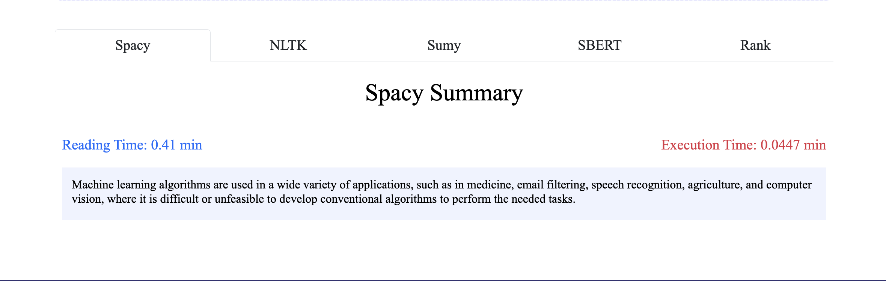
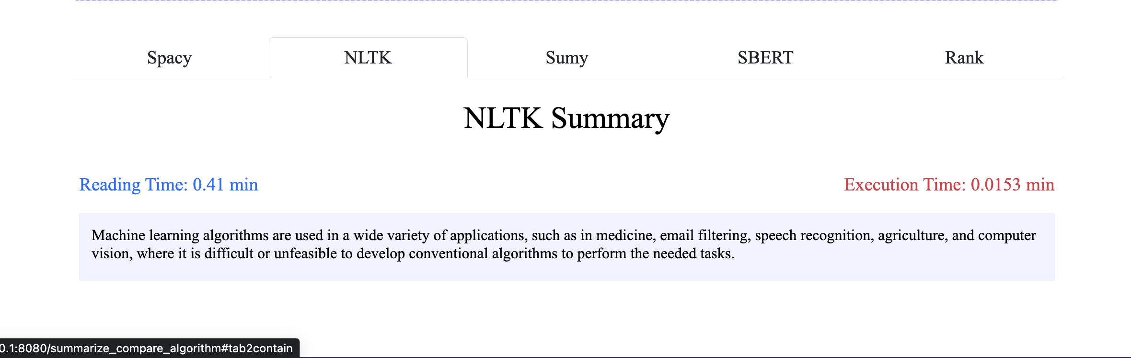
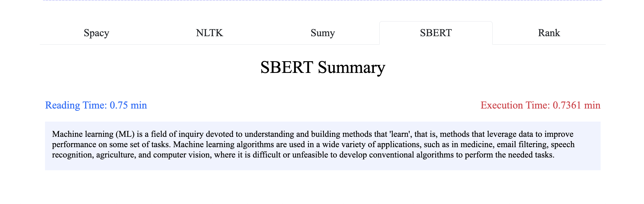
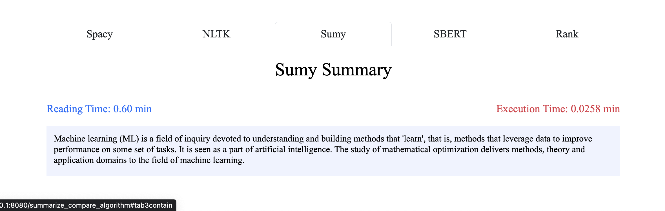
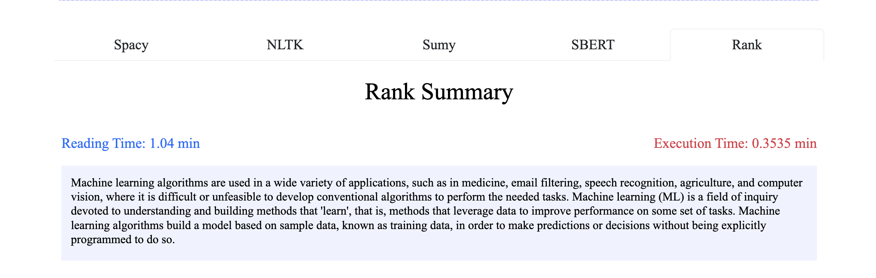
Features:
Compare Various method of summarization

Slide 26
Other Features:
Approximate Reading time of text.
Execution time of algorithms

Slide 27
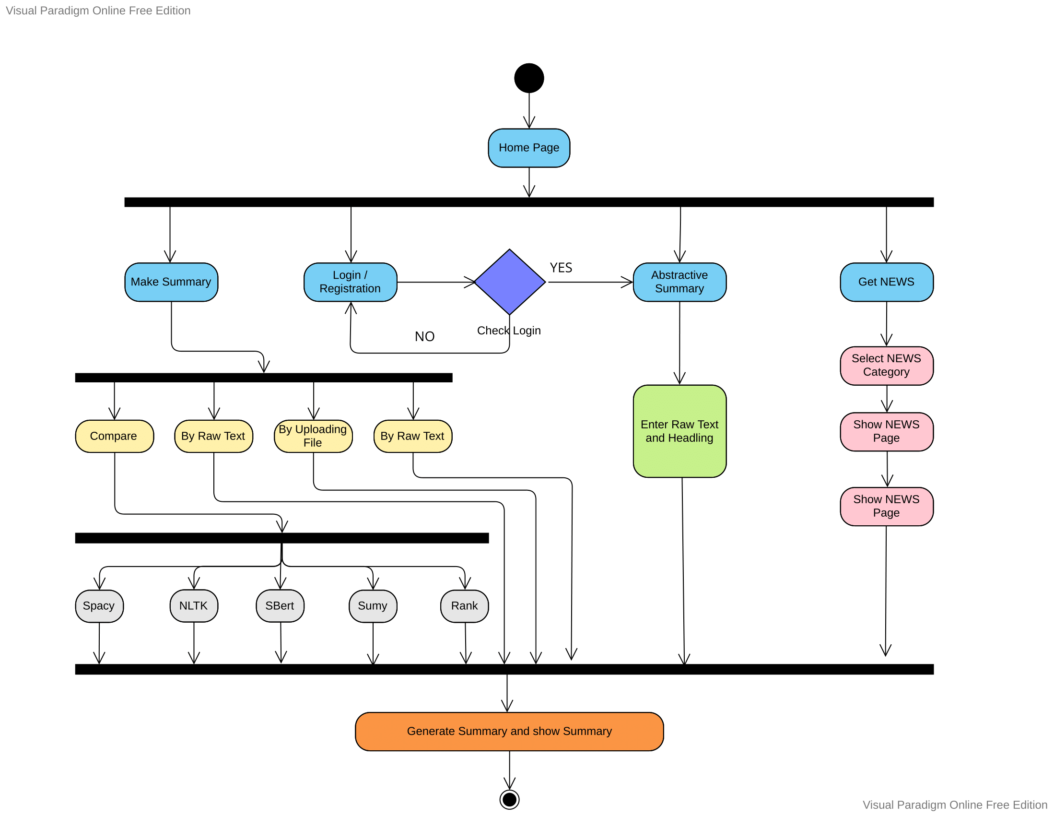
Implementation
Figure : Activity Diagram of the System

Slide 28
Implementation:
Software Requirements
Pycharm - Python editing
Visual Studio Code - front end editing
Google Colob – to train and save model
Flask – backend development
SQLAlchemy – database management
Beautiful Soup – web scraping
Render – to Host our website

Slide 29
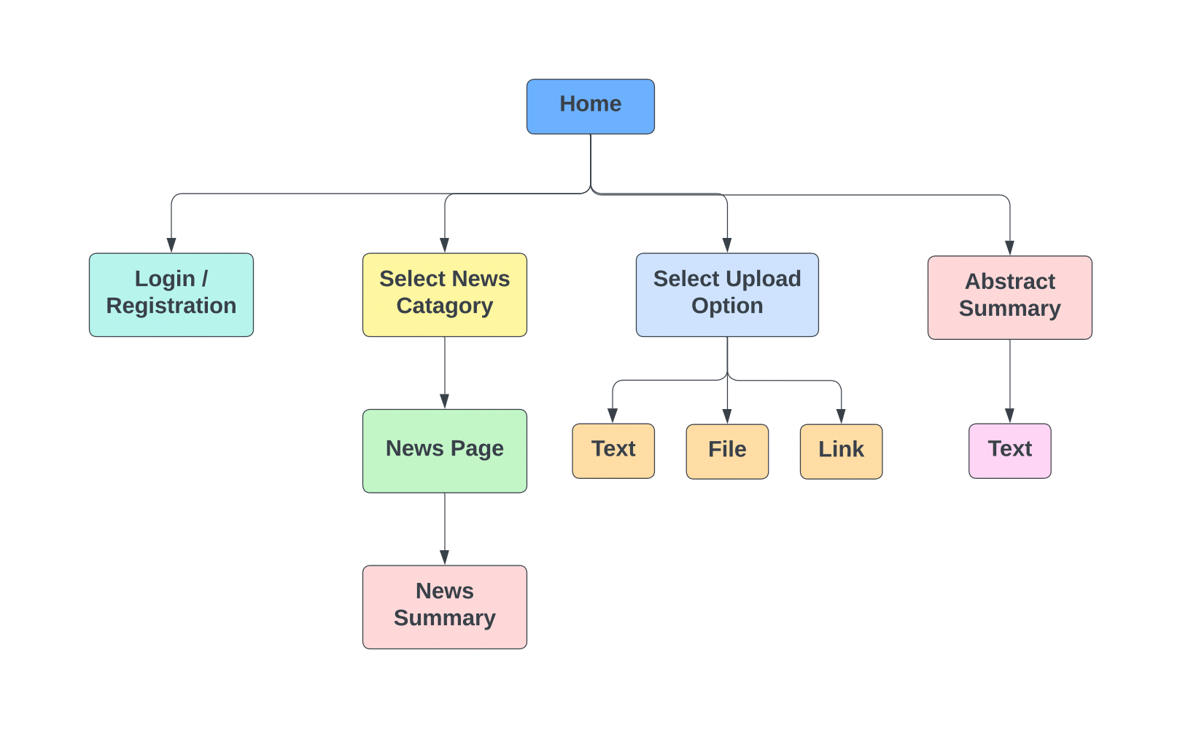
Implementation
Figure : System Architecture

Slide 30
Future Scope for improvement
Provide Summary by uploading file other than text file like picture or pdf.
Questioning answer bots.
Search marketing and SEO.
Speech to summarized text.

Slide 31
Conclusion
The system was designed to provide the most important information from the given text to the end users.
News summarization , one of the application of text summarization was also implemented.
Comparison of various types of text summarization was also demonstrated.
The goal was achieved to some extent.

Slide 32
References
https://www.rapidtables.com/tools/pie-chart.html
https://broutonlab.com/ghost/content/images/blog/summarization-of-medical-texts-machine-learning/summarization-of-medical-texts-machine-learning.jpg
https://broutonlab.com/ghost/content/images/blog/summarization-of-medical-texts-machine-learning/abstractive-summarization-using-machine-learning.jpg
https://lucid.app/lucidchart
https://online.visual-paradigm.com/
https://www.frase.io/blog/20-applications-of-automatic-summarization-in-the-enterprise

Slide 33
Thank You!

